Slide 1
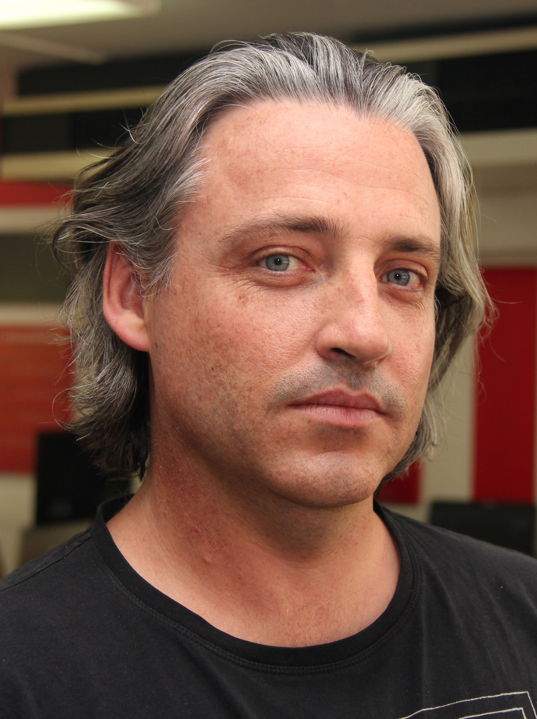
Adam Stephensen
http://adamstephensen.com
@AdamStephensen
Solution Architect at SSW
Building Awesome Teams and Software
Focus on Enterprise Web and Development Best Practices
Principal Mentor @ FireBootCamp
Microsoft Australia Partner Award for Learning

Slide 2

TESTING (After lots of initial pain)
@Adamstephensen | Solution Architect @ SSW
Notes:
I’ve just finished my first application using Visual Studio 2015, MVC 6 and AngularJs
I’m so excited to be be building enterprise web apps, leveraging all the front end best practices developed by the javascript community, using my C#, MVC and WebAPI skills for the backend and doing it all with the productivity of visual studio, .

Slide 3
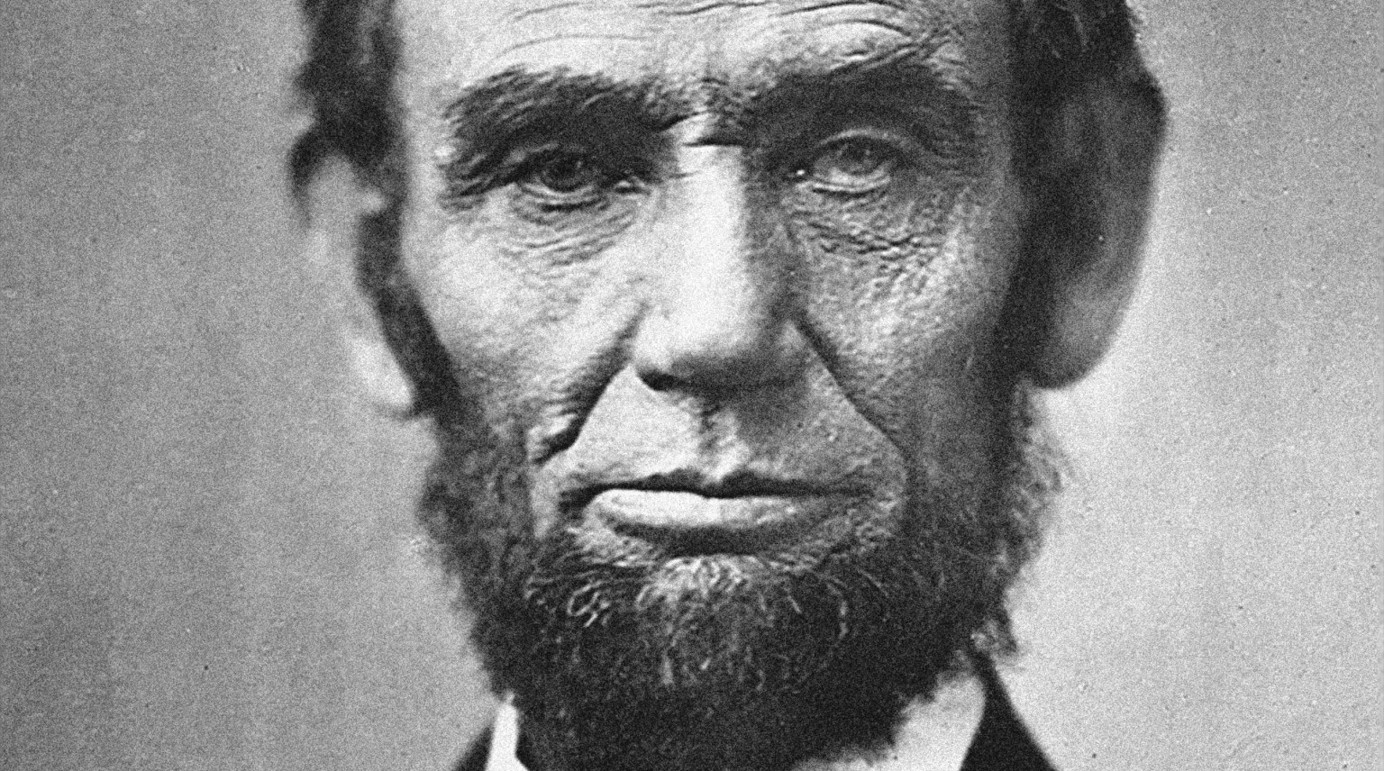
DO ALL
THE
TESTING

Slide 4
The state of testing
Code
VS Unit Tests (recommended)
Nunit Tests
UI
Coded UI Tests with MTM
Selenium + Chutzpah (recommended)
Javascript
JSUnit
Qunit (made by the jQuery team)
Mocha (new comer)
Jasmine + Chutzpah (recommended)

Slide 5
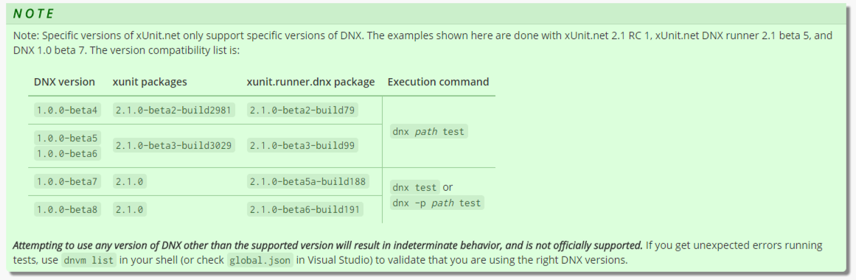
Warning: You have to get your versions right

Slide 6
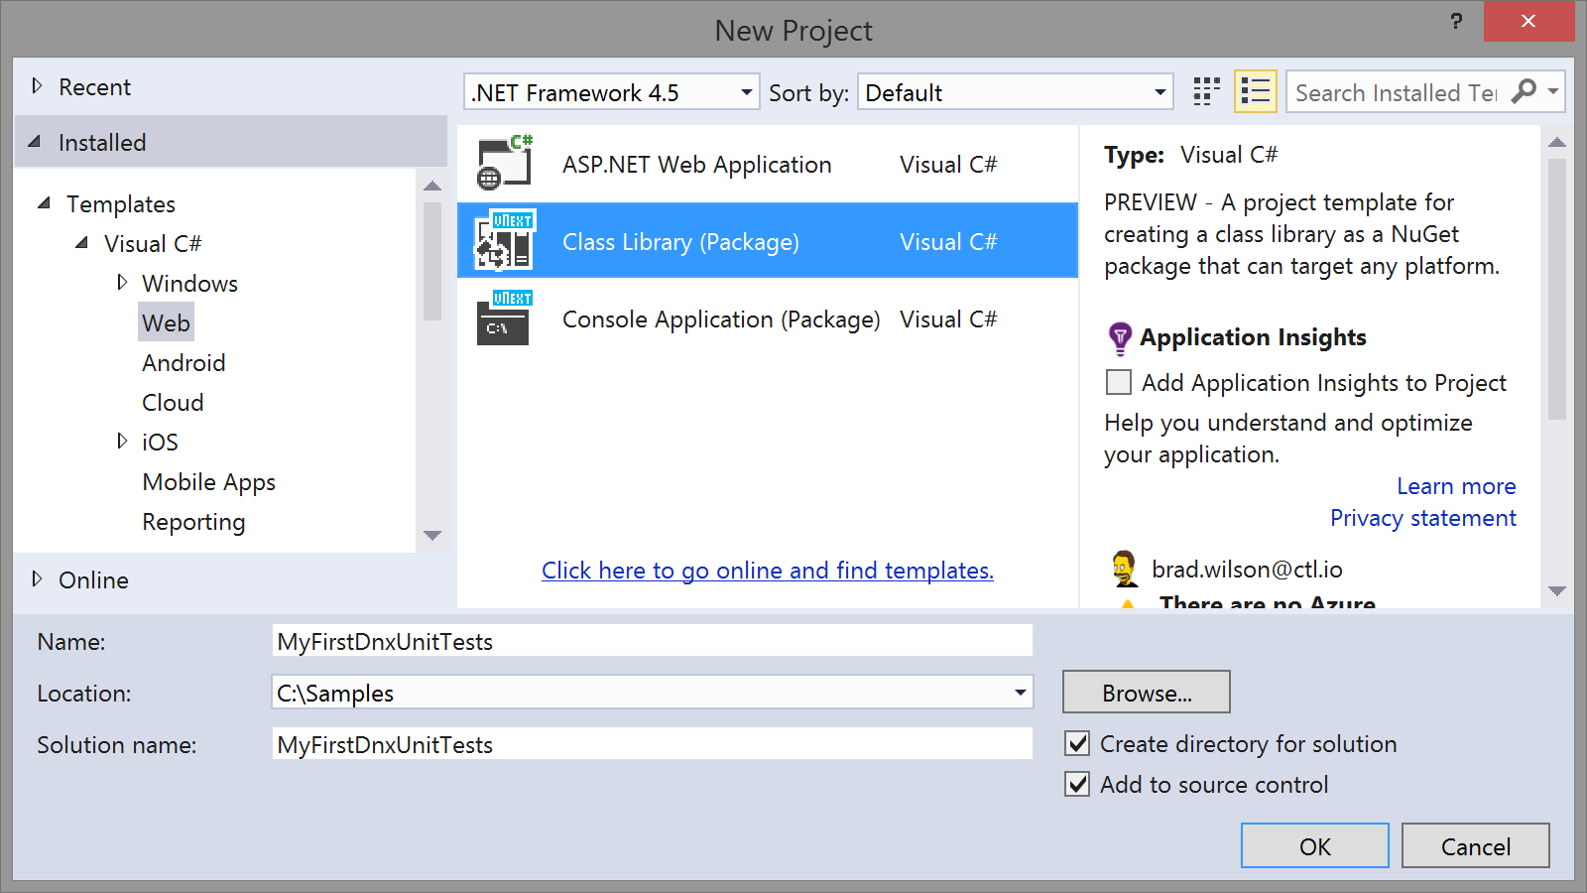
Create a class library package

Slide 7
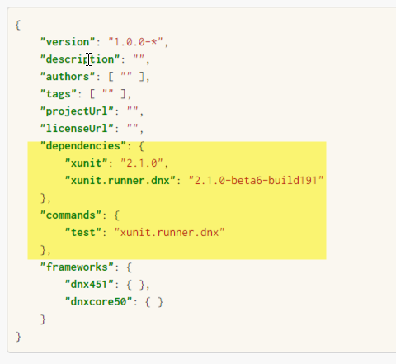
Add a reference to xunit in project.json

Slide 8
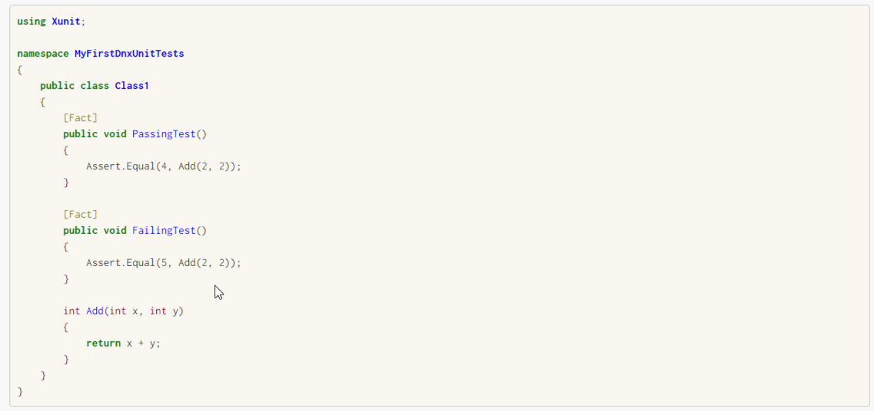
Write your first test

Slide 9
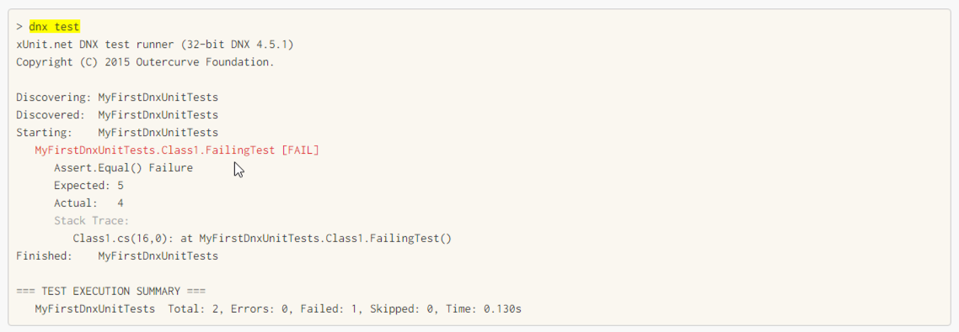
Run it from the command line

Slide 10
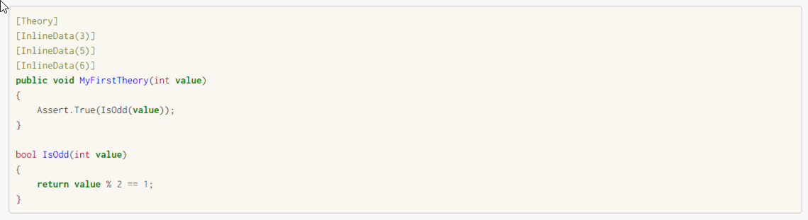
Write your first theory
Notes:
Facts are tests which are always true. They test invariant conditions.
Theories are tests which are only true for a particular set of data.

Slide 11
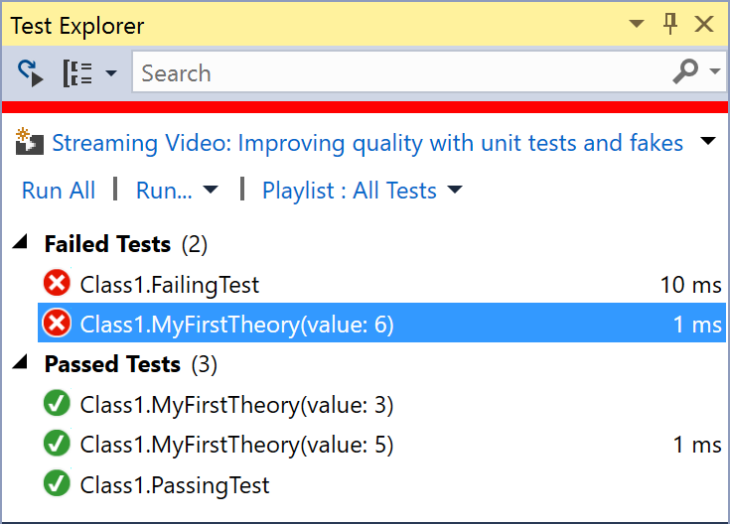
Run Tests from Visual Studio (Test | Windows | Test Explorer)

Slide 12

Summary Thank you: You helped me know what's awesome!
Add reference to Xunit
Write our first Xunit test
Use Theories
Run Tests from the Command line
Run Tests from Visual Studio
Summary

Slide 13
Thank you! info@ssw.com.au www.ssw.com.au Sydney | Melbourne | Brisbane | Adelaide
Tweet your favourite feature
@AdamStephensen #NetUG
Notes:
Thanks for listenting, and please drop me a tweet with your feedback

